Slide 1
Flipkart Sales Analysis
Dashboard
Sujal Patil

Slide 2
INTRODUCTION
This project is Flipkart sales Analysis Dashboard built using Power BI.
The goal was to analyze sales performance, product categories, regional trends, payment methods, and customer ratings..
Converts raw data into interactive and meaningful insights for better decision-making.

Slide 3
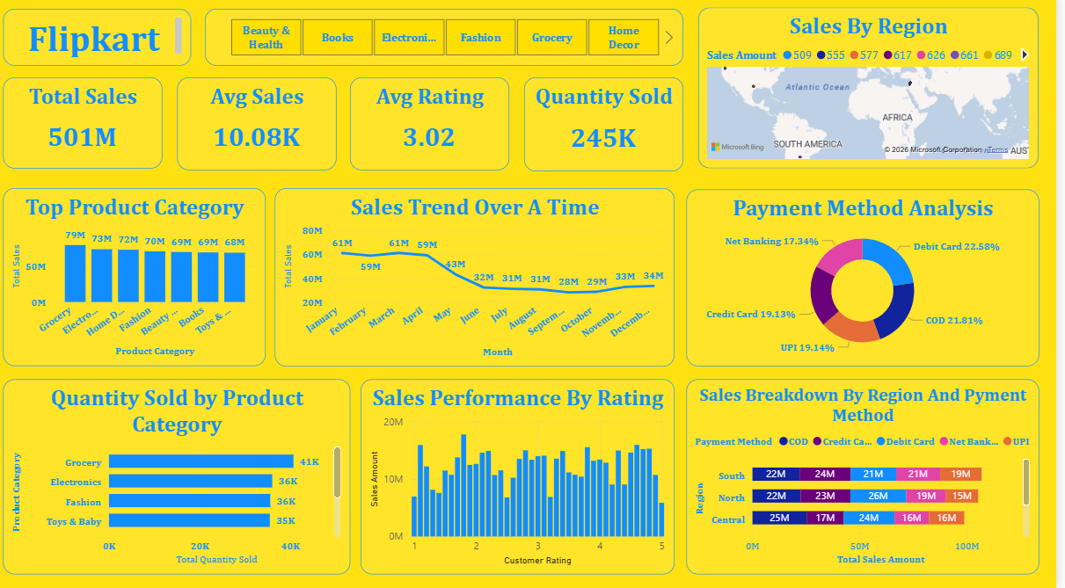
OVERVIEW
Main dashboard page connecting all analysis sections Provides access to sales, categories, regions, payments, and performance insights Designed to be interactive, simple, and user-friendly

Slide 4
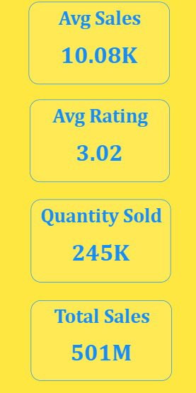
Key Metrics
Total Sales: 501M
Average Sales: 10.08K
Average Rating: 3.02
Quantity Sold: 245k

Slide 5
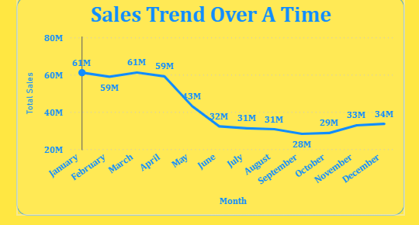
Sales Insights
Sales fluctuate over time with noticeable peaks
Certain months show strong growth trends
Potential seasonality in demand

Slide 6
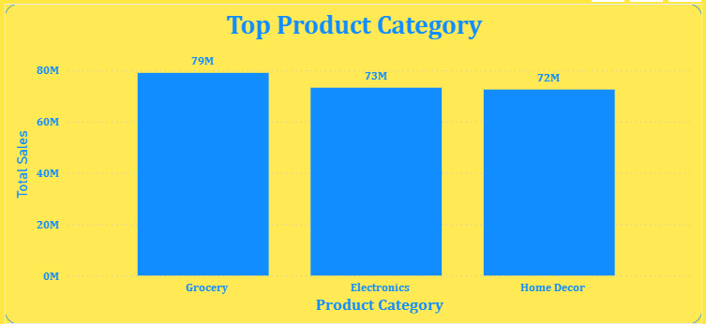
Product Category Analysis
Top categories include Grocery, Electronics, and Fashion
Balanced contribution across categories
Opportunities for category-based marketing

Slide 7
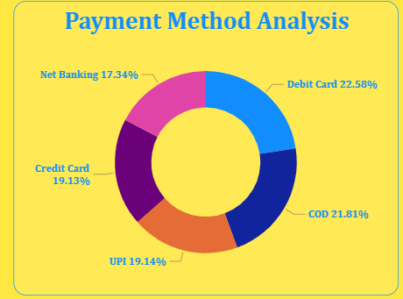
Payment Method Insights
COD and Debit Cards dominate usage
UPI adoption is growing
Net Banking has lower contribution

Slide 8
Business Recommendations
Focus marketing on high-performing regions
Promote digital payment methods
Optimize inventory for top categories
Leverage seasonal trends

Slide 9
CONCLUSION
Dashboard provides actionable insights
Supports strategic decision-making
Scalable for future data integration

